Slide 1
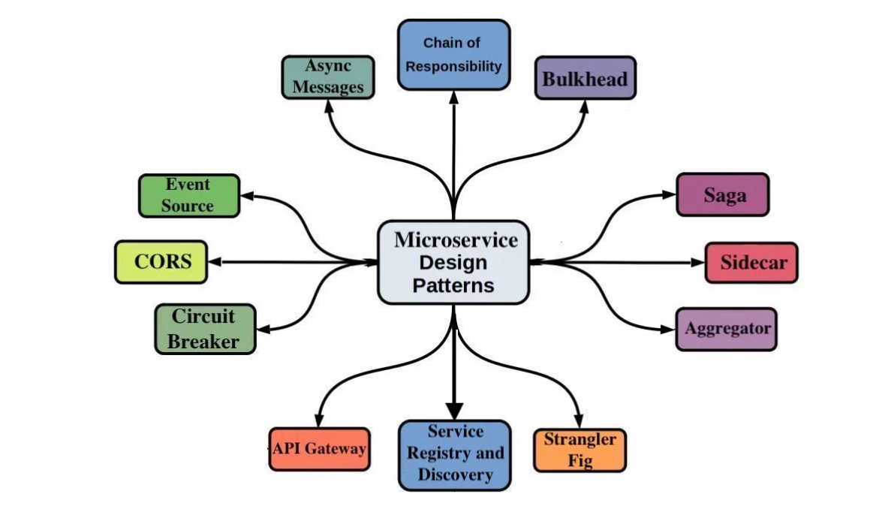
Microservices and its design patterns with examples - - VIJAY KODE
https://github.com/VijayKode/micro-services

Slide 2
Course Outline
Api Gateway Pattern
Saga Pattern
Command query responsibility segregation (CQRS)
Event Sourcing
Circuit breaker Pattern

Slide 3
Course Outline
Strangler pattern
Database Per Service

Slide 4
API Gateway Pattern
The API Gateway acts as an intermediary layer that exposes APIs to clients without revealing the internal details of service partitioning or boundaries.
Benefits of This Feature
Simplified Client Logic: Clients don't need to maintain the knowledge of which microservices to call for specific features. Now clients need not to keep note of all paths and services.
Flexibility in Service Management: Developers can evolve, scale, or rearchitect services without affecting client applications. The abstraction allows services to evolve independently (e.g., split, merge, or change APIs) without directly impacting the clients.
Encapsulation: The internal architecture of the microservices remains hidden, improving security and reducing external dependencies.
Real-Life Examples
Netflix: Their API Gateway (Zuul) abstracts their microservices and provides a single point for managing client requests.

Slide 5
Cons of Api Gateway Pattern
Single point of entry can lead to single point of failure.
Single authentication can lead to single point of attack.
Becomes the bottleneck if not scaled properly.
Has to be managed and deployed continuously.
Can Introduce latency because one extra step is required for finding the service.

Slide 6
Other features with Spring cloud gateway pattern
Able to match routes on any request attribute.
Predicates and filters are specific to routes.
Hystrix Circuit Breaker integration.
Spring Cloud DiscoveryClient integration – for loadbalancing
Easy to write Predicates and Filters – to match the service
Request Rate Limiting -- no of requests a client can make per second
Path Rewriting – we can change the path of incoming request

Slide 7
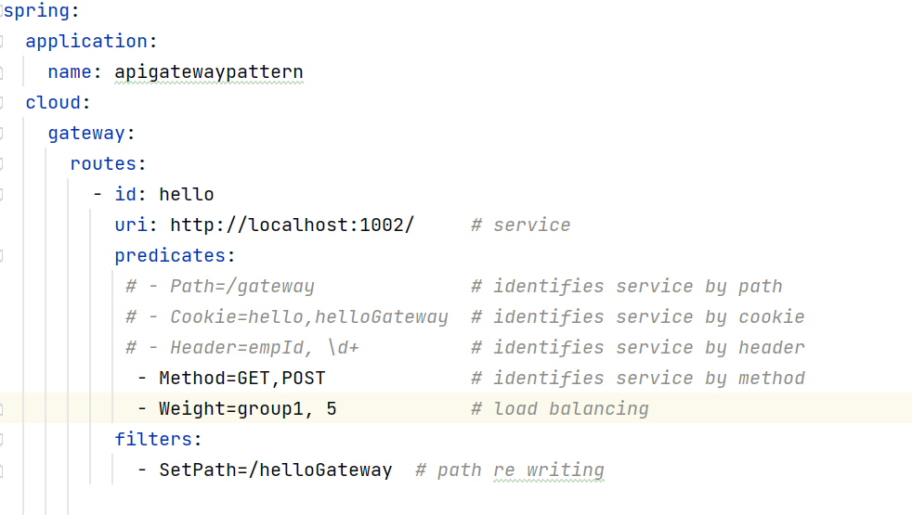
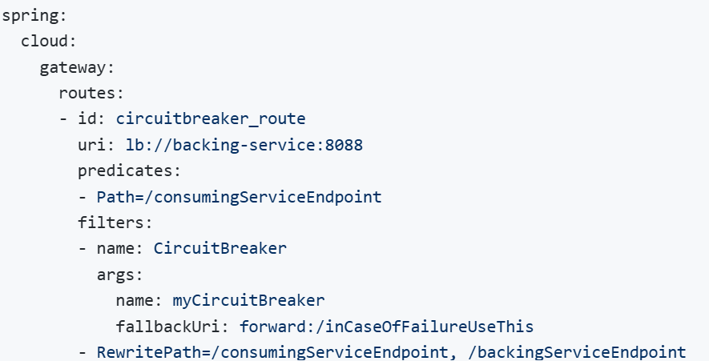
Sample config

Slide 8
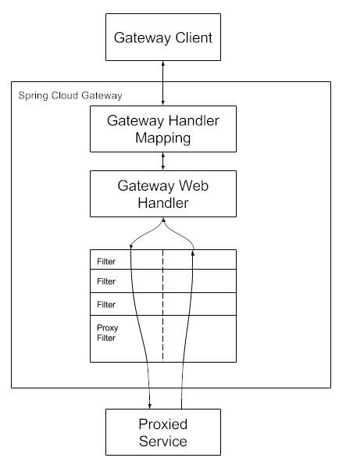
Working
Clients make requests to Spring Cloud Gateway. If the Gateway Handler Mapping determines that a request matches a route, it is sent to the Gateway Web Handler. This handler runs the request through a filter chain that is specific to the request. The reason the filters are divided by the dotted line is that filters can run logic both before and after the proxy request is sent. All “pre” filter logic is executed. Then the proxy request is made. After the proxy request is made, the “post” filter logic is run

Slide 9
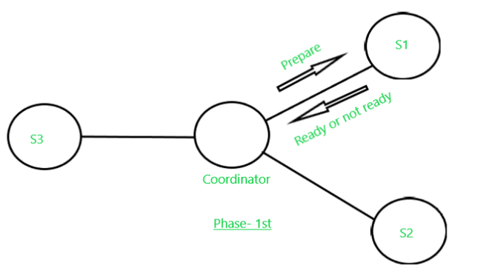
2PC: (2phase commit)
Phase 1: Prepare Phase
The Transaction Coordinator (TC) sends a prepare request to all participating nodes.
Each participant does the following:
Executes the transaction locally up to the point where it can safely commit.
Acquires necessary locks on the resources to prevent changes by other transactions.
Persists the transaction's changes in a log (write-ahead log) but does not commit.
Sends a vote (YES or NO) back to the TC.
If any participant votes NO, the transaction is aborted.

Slide 10
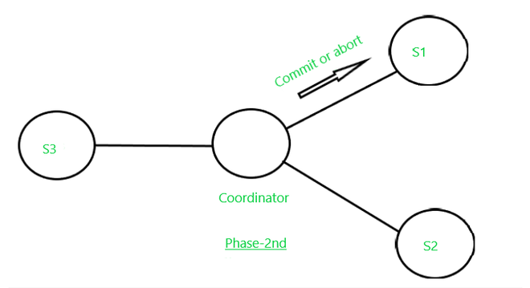
Phase 2: Commit Phase
If all participants vote YES, the TC sends a commit request to all participants.
Participants commit the transaction and release locks.
Participants send a confirmation back to the TC.
If any participant votes NO or fails to respond, the TC
sends a rollback request to all participants.
Participants undo any changes made during the prepare
phase and release locks.
Advantages: Atomicity can be achieved across systems.
Disadvantages: Blocking of resources and tight coupling as communication is synchronous.

Slide 11
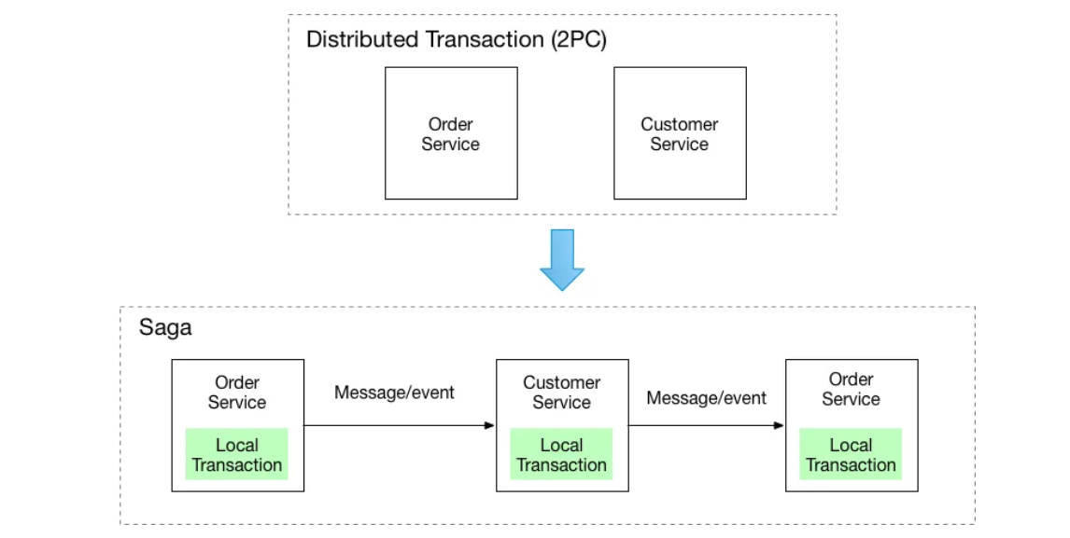
SAGA Pattern
Note: Earlier 2Pc was there and that can be converted to saga
A saga is a series of local transactions. In microservices applications, a saga pattern can help maintain data consistency during distributed transactions.
What are distributed transactions?
Distributed transactions are transactions that span multiple
independent systems, databases, or services, ensuring
consistency and atomicity across all of them. In other words
they ensure that a single transaction involving multiple
distributed components either completes successfully
everywhere or is rolled back everywhere to maintain a
consistent state.

Slide 12
Approaches of Saga
1. Choreography:
Service itself decide which and when to invoke other services in response of an event.
More Flexible
Decentralized
2. Orchestration:
An object or orchestra at center decides which service and when to invoke.
Centralized
Easy To monitor

Slide 13
CQRS
It involves separation of read model with write model.
What are the benefits?
When application is ready heavy, separating read and write models helps in faster retrieval of data.
Helps to prevent shared locks created by DB over resources while reading and can helps in faster writes.
Disadvantages:
Read side does not immediately reflect write side changes (eventual consistency).
May need to separate DB or need to create normalized and deformalized views, which can lead to data duplication.

Slide 14
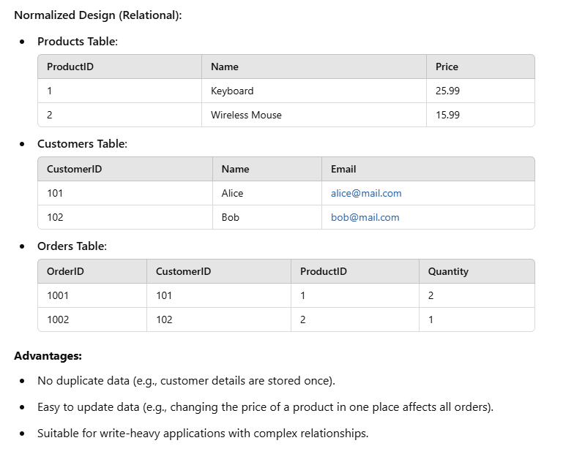
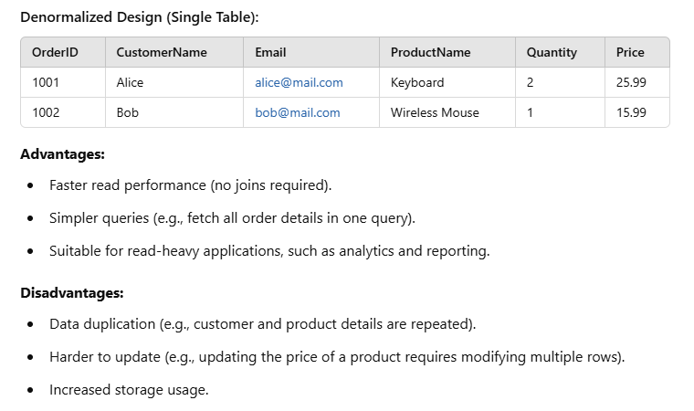
UseCases:
Often used for read heavy applications like ecommerce, banking.
Example:

Slide 15
Event Sourcing
The event sourcing design pattern is used in microservices when there is a need to capture all changes in an entity’s state. Generally, these events are stored in DB like Eventstoredb.
The current state of resource/entity can be reconstructed by replaying all its previous states.
Event sourcing can be used along with CQRS to update read model.

Slide 16
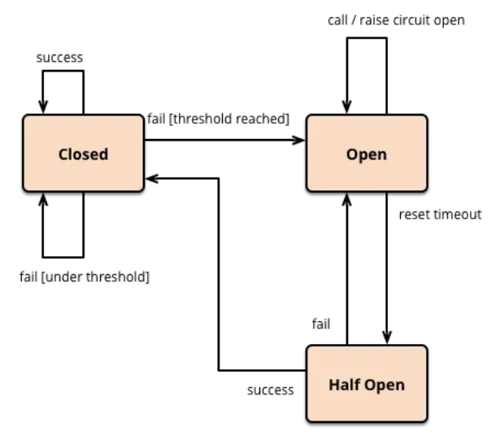
Circuit Breaker Pattern
The circuit breaker has three main states:
Closed (Normal Operation):
Requests are allowed through as usual.
The circuit breaker monitors for failures (e.g., errors, timeouts).
If failures exceed a defined threshold, the breaker "trips" to Open state.
Open (Fail Fast):
Requests are immediately rejected without contacting the service.
This reduces load on the failing service and gives it time to recover.
The circuit breaker stays in this state for a defined timeout period.
Half-Open (Trial):
After the timeout, the circuit breaker moves to Half-Open state.
It allows a limited number of requests to test if the service has recovered.
If the test requests succeed, the breaker returns to Closed state.
If failures continue, it reverts to Open state.

Slide 17
When to use circuit breaker
Prevents cascading failures by stopping the failure of one service from affecting others.
Avoids resource exhaustion by halting calls to unresponsive services.
Supports partial outputs through fallback mechanisms like caching or degraded responses during downtime.
Prevents cascading failures by stopping the failure of one service from affecting others.
Avoids resource exhaustion by halting calls to unresponsive services.
Supports partial outputs through fallback mechanisms like caching or degraded responses during downtime.

Slide 18
Strangler Pattern
The Strangler Pattern is used for incrementally modernizing legacy systems by gradually replacing old components with new ones while keeping the system operational.
How It Works:
Develop new components to replace legacy functionality.
Redirect traffic from the old system to the new one using an API gateway or proxy.
Allow both systems to coexist until all functionality is migrated.
Decommission the legacy system once migration is complete.
Benefits:
✅ Low risk, as changes happen incrementally. ✅ Ensures business continuity without downtime. ✅ Faster modernization with flexible migration.
Challenges:
⚠️ Managing old and new system communication. ⚠️ Potential duplication of functionality during migration.

Slide 19
Database per service
✔ Each service has its own database, ensuring loose coupling in a distributed system.
When to Use:
When designing a distributed transaction architecture.
When services have different technology requirements (SQL/NoSQL).
Challenges:
Ensuring ACID compliance across multiple databases is complex.
Distributed transactions require SAGA (event-driven compensation) or 2PC (Two-Phase Commit).

